Slide 1
Stylised Text Generation
Using neural networks to imitate internet forum posts

Slide 2
Contents
Language models and text generation
Our text
Text to machine learning problem
Designing a network
Results
Challenges
Lessons learned
Future work

Slide 3
Language Models
Given a type of text we want to model the distinct style
Newswire, internet forums, formal correspondence, technical document
Classically done using n-gram counts and conditional probability over sequences of words/sub-words/letters
“There are sheep in the ____”
P(“field”|”There are sheep in the”) > P(“sea”|”There are sheep in the”)
P(n_{i+1} | n_{i-4} n_{i-3} n_{i-2} n_{i-1} n_{i} )
How do we calculate this probability?
n-gram: sequence of n items, such as words. (“I”, “am”) – bigram, (“I”, “am”, “a”) – trigram and so on.

Slide 4
N-gram conditional probability - example
Our corpus:
We can do this for all words in a corpus
I like cats
I like dogs
I like walking
I love dogs
I like cats
I hate flying
You like cats
P(“cats”|”I like”) = 2/4
P(“flying”|”I like”) = 0/4
P(“dogs”|”I like”) = 1/4
P(“cats”|”like”) = 3/5
P(“dogs”|”love”) = 1/1
P(“turtles”|”like”) = 0/5
Number of sequences: 7
corpus: collection of texts used to build a model

Slide 5
Text Generation
Extend language models to prediction
Given an input sequence of words (seed) predict the most likely next word
Add that word to the seed sequence, repeat
Seed sequence: “I like walks” Using a fixed length sequence of 3 (trigram)
P(word*|”I like walks”) – select the word that maximises this probability.
word* : “on”
P(word*|”like walks on”) – select the word that maximises this probability.
word* : “the”
P(word*|”walks on the”) – select the word that maximises this probability.
word* : “beach”
Generated sequence: “I like walks on the beach”

Slide 6
Text Data – r/relationships
Post follow a typical style and are only on a set of topics (relationships)
Individuals post to this forum asking for relationship advice. The title of their post gives a brief description of the problem they are having.
Reddit API gives a maximum 1000 posts, not enough. I used the `praw` reddit warehouse api and `psaw` wrapper to access more data.

Slide 7
Text pre-processing
Removing unwanted characters
Unnecessary punctuation
Excessive whitespace
Keras tokenizers are good – but it helps to reduce the variety of inputs
Finding the size of the vocabulary (unique set of words)
Find the max and min post title lengths
Convert text to numeric

Slide 8
Text to sequences - ML classification problem
Convert text into fixed length word sequences
Gives us features: (n_{i-2} n_{i-1} n_{i})
and a target: n_{i+1}
Example sequence length: 4
Features - X
Target - y
Corpus:
“Help my husband will not stop hiding my video games”
n_{i-2} | n_{i-1} | n_{i} | n_{i+1}
Help | my | husband | will
my | husband | will | not
husband | will | not | stop
will | not | stop | hiding
not | stop | hiding | my
stop | hiding | my | video
hiding | my | video | games
Given our corpus of 10 words we now have 7 feature-target pairs to train a model on. The model will predict the next word given a seed.
Machine Learning classification problem: using feature-target pairs to learn a function which predicts target values when given features.

Slide 9
Designing a network
Words inputs – convert to embeddings
Sequence to single output – use recurrent neural network
Semantic relationships (not just the previous word) – use Long-Short Term Memory recurrent neural network units
Prevent overfitting – dropout, regularisation, early stopping
Predict a word from the vocab - each word represented by a node
One single output – a final hidden unit

Slide 10
Network (rough) diagram
Hidden Layer (length of vocab units)
Embedding layer
LSTM/GRU Units
Dropout layer
n_{i-2} | n_{i-1} | n_{i}
n_{i+1}
Single hidden layer
prediction
Loss function: sparse categorical cross entropy optimiser: Adam

Slide 11
Generating new text
Convert input to sequences + embeddings – generate a prediction, convert prediction from numeric to word
Add new word to end of sequence
Run prediction again on new sequence
You now have text generated
Initial seed
Ignored words in prediction
Input features
Output prediction
“My” “boyfriend” “keeps”
“My” “boyfriend” “keeps” “talking”
“My” “boyfriend” “keeps” “talking” “about”
“My” “boyfriend” “keeps” “talking” “about” “his”
“My” “boyfriend” “keeps” “talking” “about” “his” “text”
“My” “boyfriend” “keeps” “talking” “about” “his” “text” “generator”

Slide 12
Results - Examples
Some outputs have been clipped
My husband (30m) wont let me go through a rough patch in our relationship .
My spouse is going on a date with someone and dont know what to do .
Help, my (21F) boyfriend has had a huge connection with me etc . . ) , i am very disturbed by it and i dont know how to react
My spouse has been acting in the wrong ? (18/19m) ?
My husband has a new friend who has been upset ? ? i dont know how to do about it ? if i was a significant time ?
My spouse is going on a date with someone and dont know what to do . i feel hopeless despite him in the wrong way ?

Slide 13
Results - overfitting
Common phrases/sequences in the posts introduce cycles of repeated generation
My gf has not upset . i dont know how to do about it ? if i was a significant time ? i dont know how to do about My wife is not sure how to change my boyfriend (24m) of a relationship . i dont know how to do about it ? if i was a significant
My wife (30f) of 3 years and i dont know what to do . . . . .
My (22M) and i dont know what to do . . . . . .
My boyfriend (30m) of six years and i dont know what to do . . . . . .
My wife and i dont know how to get back . . . . . . . . . . . . . . . . .
My (22M) and i dont know how to get back . . . . . . . . . . . . . . . . .
My girlfriend ? but i dont know how to get back . . . . . . . . . . . . . . . .
My boyfriend (25m) is getting a relationship ? but i dont know how to get back . . . . . . . . . . .
My friend ? ? ? ? ? ? ? ? ? ? ? ? ? ? ? ? ? ? ? ? ? ? ? ? ?

Slide 14
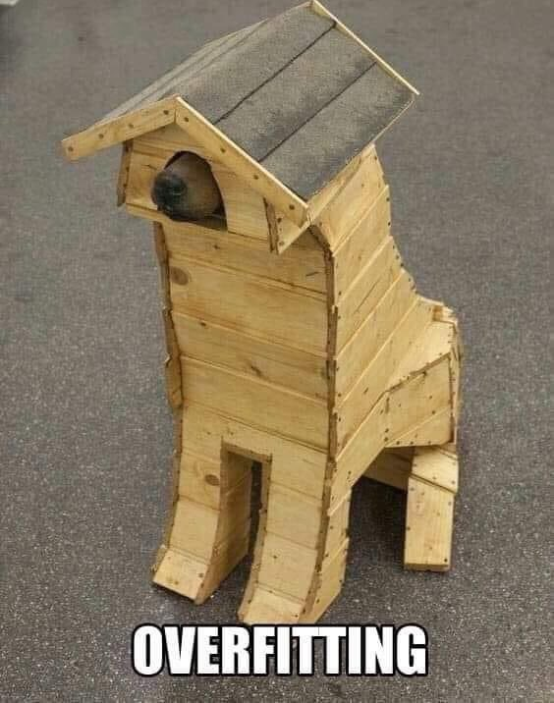
Challenges
Overfitting
Selecting appropriate model parameters
Longer sequences – higher accuracy, requires bigger seed, more training
Shorter sequences – less training required, small seed, less coherent
Computational time / resources for training
Memory for pre-processing
“Limit” of classification problem – same input different outputs
For 5000 posts, sequences of length 4, ~25% of feature-target pairs are non-unique.
This gets higher as size of training data increases.
Both appear in corpus:
“My husband is” -> “great”
“My husband is” -> “really annoying”

Slide 15
Lessons Learned
Choice of data structure is important
Tuples + generators > lists
Standard library very powerful (collections, functools, itertools)
Understand the objective
Was I designing the model to produce a good validation accuracy/loss or to create text that made sense?
Early Stopping crucial

Slide 16
Future work
Looks at a different subreddit/comments
Try letter/sub-word sequences
Explore gender-age tokens (72M)
Use a pre-trained language model like BERT (trained on reddit posts) and do transfer learning (if I had a GPU)
Build a nicer UI
Refactor to a pipeline

Slide 17
Bonus odd sequences generated
I don't ? do i do ? should i wait ? need advice , how do i deal with my landlord(56f)
Help reddit, my husband is engaged in a room and not the livingroom ? ? ? its driving me crazy . am i overreacting ?
I need help with your partner ? (29m) i think hes a bad person for telling my friend (29m)
Help, my (21F) boyfriend has had a huge connection with me etc . . ) , i am very disturbed by it and i dont know how to react

Slide 18
Any questions?
jonathon.mellor@ons.gov.uk

